Slide 1

Chapter 6
Forms

Slide 2

Objectives
Introduces web forms, a method of sending information from the browser to the web server.
Will learn about the differences between sending form data in a GET HTTP request and sending it in a POST HTTP request.
Will know how Django's form library is used to build and validate forms automatically.

Slide 3
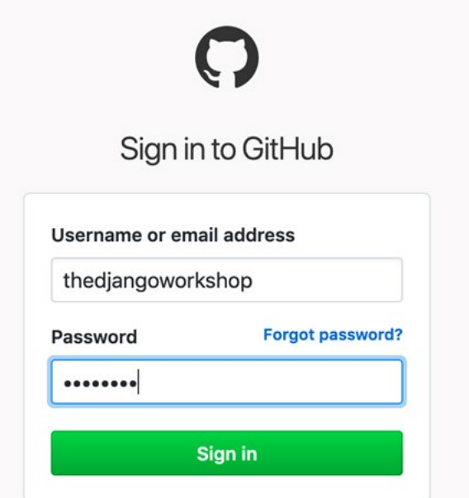
What Is a Form?

Slide 4
The <form> element?
method
This is the HTTP method used to submit the form, either GET or POST. If omitted, this defaults to GET (because this is the default method when typing a URL into the browser and hitting Enter).

Slide 5
The <form> element?
action
This refers to the URL (or path) to send the form data to. If omitted, the data gets sent back to the current page.
enctype
This sets the encoding type of the form. You only need to change this if you are using the form to upload files

Slide 6
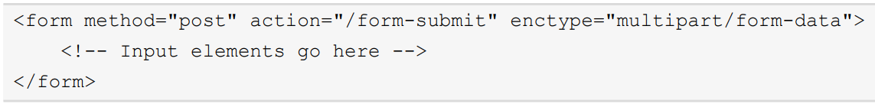
The <form> element?
This form will submit its data with a POST request to the /form-submit path, encoding the data as multipart/form-data.

Slide 7
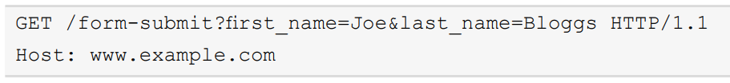
The <form> element?
A form submitted using GET sends its data in the URL, like this.

Slide 8
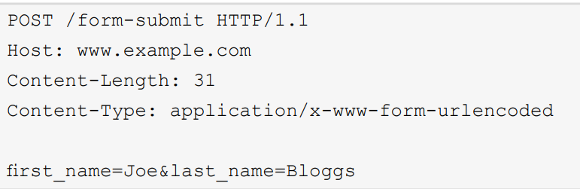
The <form> element?
A form submitted using POST sends its data in the body of the request, like this:

Slide 9
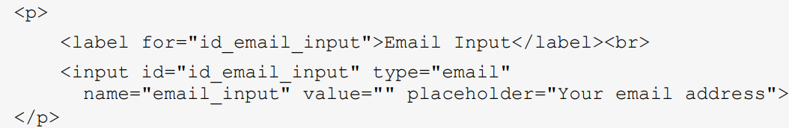
Types of Inputs
Most inputs are created with an tag, and their type is specified with its type attribute.

Slide 10
Form Security with Cross-Site Request Forgery Protectio
A CSRF attack exploits the fact that a form on a website can be submitted to any other website. The action attribute of form just needs to be set appropriately.
The CSRF token must be added into the HTML for every form being sent and is done with the {% csrf_token %} template tag.

Slide 11
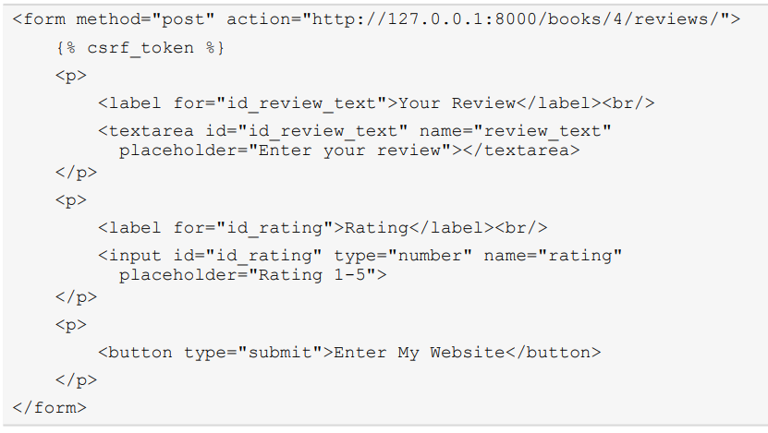
Form Security with Cross-Site Request Forgery Protectio

Slide 12
Why Use GET When We Can Put Parameters in the URL
Django allows us to easily define URL maps that contain variables. We could, for example, set up a URL mapping for a search view like this:

Slide 13
Why Use GET When We Can Put Parameters in the URL
We might want to be able to move from one results page to the next, so we add a page argument.

Slide 14

Why Use GET When We Can Put Parameters in the URL
And then we might also want to order the search results by a specific category, such as the author name or the date of publishing, so we add another argument for that:

Slide 15


Why Use GET When We Can Put Parameters in the URL
Contrast this to using query parameters: all of them are optional, so you could search like this:

Slide 16
The Django Forms Library

Slide 17
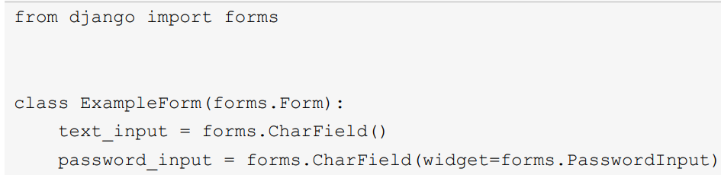
Defining a Form
You define a class that inherits from the django.forms.Form class. The class has attributes, which are instances of different django.forms.Field subclasses.

Slide 18
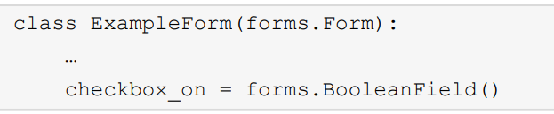
Defining a Form
A checkbox is represented with BooleanField, as it can have only two values, checked or unchecked. It's added to the form in the same way as the other field.

Slide 19
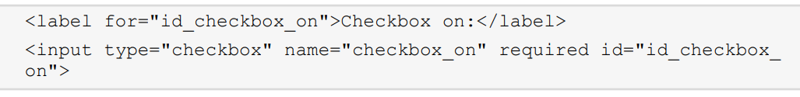
Defining a Form
The HTML that Django generates for this new field is similar to the previous two fields.

Slide 20
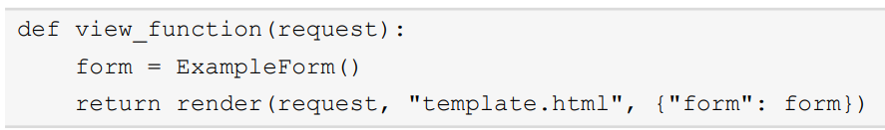
Rendering a Form in a Template
We've now seen how to create a form and add fields, and we've seen what the form looks like and what HTML is generated.

Slide 21
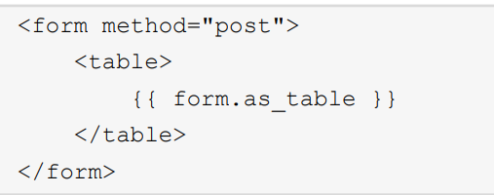
Rendering a Form in a Template
as_table
as_table is the default rendering method, so {{ form.as_table }} and {{ form }} are equivalent.

Slide 22
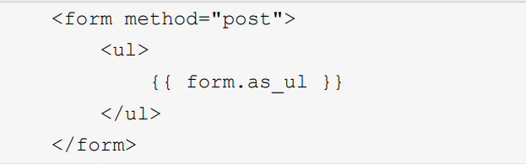
Rendering a Form in a Template
as_ul
This renders the form fields as list items (li) inside either a ul or ol element.

Slide 23
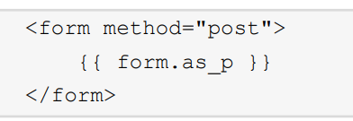
Rendering a Form in a Template
as_p
Finally, there is the as_p method, which we were using in our previous examples.

Slide 24

Validating Forms and Retrieving Python Values
In Django, a form can either be unbound or bound. These terms describe whether or not the form has had the submitted POST data sent to it for validation.

Slide 25

Validating Forms and Retrieving Python Values
A form is bound if it is called with some data to be used for validation, such as the POST data. A bound form can be created like this:

Slide 26
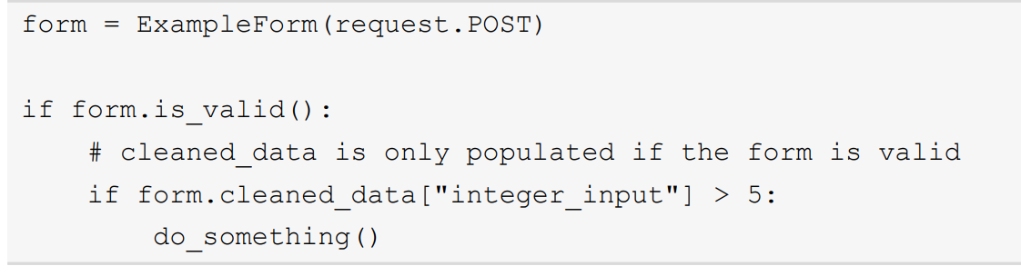
Validating Forms and Retrieving Python Values
Example of how to access the cleaned data of ExampleForm follows:

Slide 27
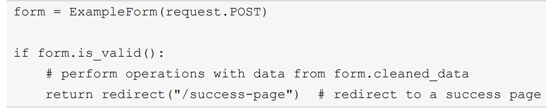
Validating Forms and Retrieving Python Values
Django is automatically rendering the form differently in the template when it has errors.

Slide 28
Built-In Field Validation
max_length
Sets the maximum number of characters that can be entered into the field; available on CharField (and FileField, which we will cover in Chapter 8, Media Serving and File Uploads).

Slide 29
Built-In Field Validation
min_length
Sets the minimum number of characters that must be entered into the field; available on CharField (and FileField; again, more about this in Chapter 8, Media Serving and File Uploads).

Slide 30
Built-In Field Validation
max_value
Sets the maximum value that can be entered into a numeric field; available on IntegerField, FloatField, and DecimalField

Slide 31
Built-In Field Validation
min_value
Sets the minimum value that can be entered into a numeric field; available on IntegerField, FloatField, and DecimalField

Slide 32
Built-In Field Validation
max_digits
This sets the maximum number of digits that can be entered; this includes digits before and after a decimal point (if one exists). For example, the number 12.34 has four digits, and the number 56.7 has three. Used in DecimalField.

Slide 33
Built-In Field Validation
decimal_places
This sets the maximum number of digits that can be after the decimal point. This is used in conjunction with max_digits, and the number of decimal places will always count toward the number of digits even if that number of decimals has not been entered after the decimal place.

Slide 34
Summary
We introduced some HTML inputs for entering data onto a web page.
We talked about how data is submitted to a web application and when to use GET and POST requests.
We then looked at how Django's form classes can make generating the form HTML simpler, as well as allowing the automatic building of forms using models.

